Slide 1


Reinforcement-Learning-Based Job-Shop Scheduling for Intelligent Intersection Management
Shao-Ching Huang¹, Kai-En Lin¹, Cheng-Yen Kuo¹, Li-Heng Lin¹,
Muhammed O. Sayin², Chung-Wei Lin¹
¹National Taiwan University, ²Bilkent University
April 2023

Slide 2
Outline
Introduction
Background
Problem Definition
Our Approach
Experimental Results
Conclusion

Slide 3
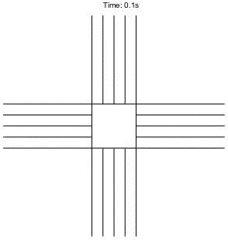
Intelligent Intersection Management
C. Liu et al., "Distributed conflict resolution for connected autonomous vehicles," 2018.

Slide 4
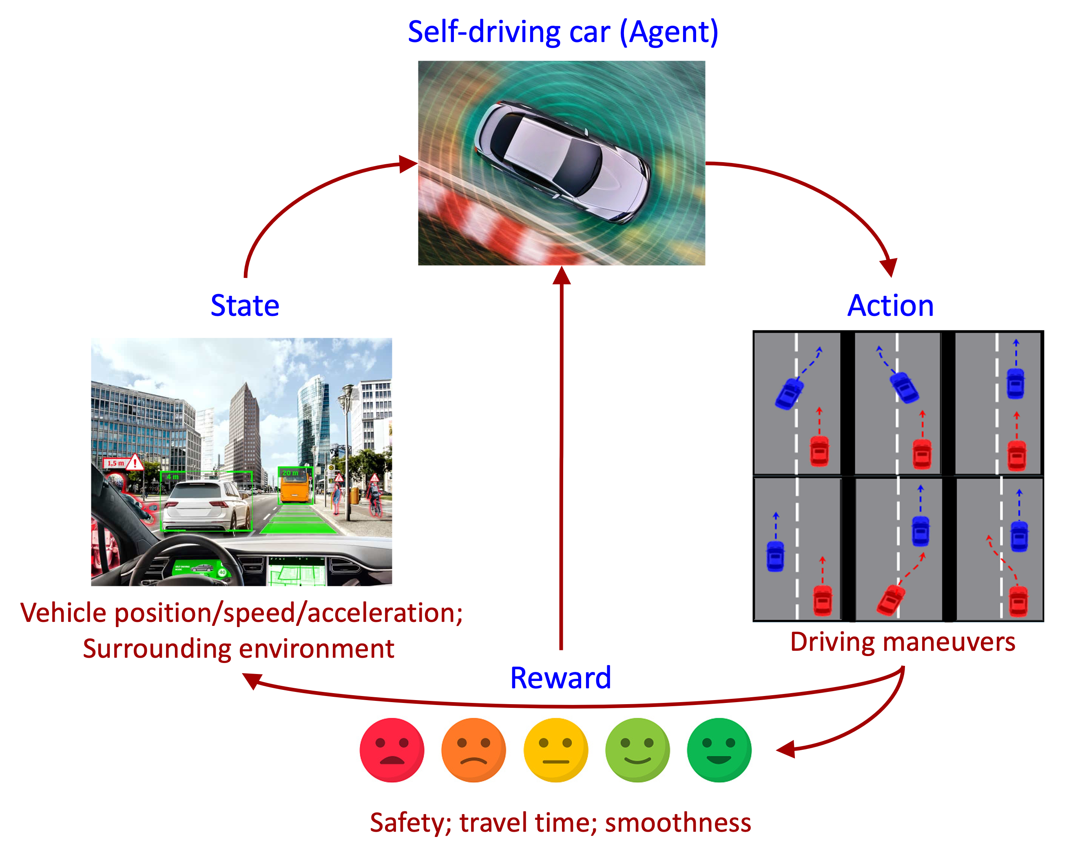
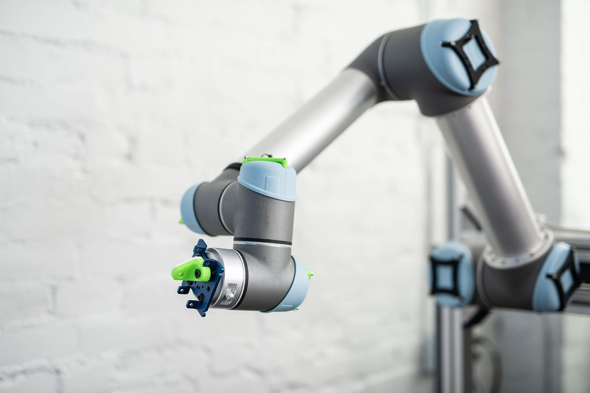
Reinforcement Learning (RL)
An agent interacts with an environment and learns a policy from its interaction experiences
Left Figure Source: https://www.ualberta.ca/science/news/2019/november/robots-help-study-reinforcement-learning.html Right Figure Source: https://www.youtube.com/live/B4RZw9kDXKc?feature=share

Slide 5
Motivations
Issue of state space explosion
We need to simplify how we represent an intersection
Applicability to general intersections
We need a general intersection model while keeping simplicity
Graph Neural Network (GNN)
Can we utilize any kind of graphs in intersection management?

Slide 6
Contributions
Apply RL to a graph-based intersection model
Bridge intersection management and RL with the Job-Shop Scheduling Problem (JSSP)
Utilize GNN and Proximal Policy Optimization (PPO) to improve performance
Identify weakness of the learning-based approach and propose potential solutions
Grouping strategy
Alternative heuristic policy when traffic density is low

Slide 7
Outline
Introduction
Background
Problem Definition
Our Approach
Experimental Results
Conclusion

Slide 8
Graph-Based Intersection Model
Conflict zone
Crossing location of two trajectories
One vehicle at a time
Conflict Zone
Y.-T. Lin et al., "Graph-based modeling, scheduling, and verification for intersection management of intelligent vehicles," 2019.

Slide 9
Graph-Based Intersection Model
Timing Conflict Graph (TCG)
Type-1 Edge: same vehicle's trajectory
Type-2 Edge: conflicts between different vehicles from the same lane
Type-3 Edge: conflicts between different vehicles from different lanes
4
1,A
1,B
1,C
3,C
D
C
Type-1
3
Type-2
A
B
2
1
2,A
4,A
4,D
3,D
Type-3
Y.-T. Lin et al., "Graph-based modeling, scheduling, and verification for intersection management of intelligent vehicles," 2019.

Slide 10
Job Shop Scheduling Problem (JSSP)
Example: a JSSP instance with 3 jobs and 3 machines, and one of its possible solutions
Job 1
Machine
M1
2hr
M3
3hr
M2
1hr
Operation
M1
2hr
1hr
2hr
Job 2
M2
4hr
3hr
1hr
M3
5hr
M2
3hr
M3
5hr
3hr
Job 3
M1
1hr
M2
4hr
M1
2hr

Slide 11
Graph-based Formulation of JSSP
A JSSP instance can also be modeled as a mixed graph
C. Zhang et al. proposed a reinforcement-learning-based approach to solve the graph-based JSSP
M1
2hr
M3
3hr
M2
1hr
M1
M3
M2
M3
5hr
M2
3hr
S
M3
M2
M1
1hr
M2
4hr
M1
2hr
M1
M2
M1
C. Zhang et al., "Learning to dispatch for job shop scheduling via deep reinforcement learning," 2020.

Slide 12
Outline
Introduction
Background
Problem Definition
Our Approach
Experimental Results
Conclusion

Slide 13
Problem Definition
An intersection I = (Z, T)
Z: the set of conflict zones
T: the set of all possible trajectories
A set of incoming vehicles X, where x_{i} = (r_{i}, t_{i}) ∈ X
r_{i}: the expected arrival time of vehicle x_{i}
t_{i} ∈ T: the trajectory of vehicle x_{i}
Given (I, X), the corresponding TCG G = (V, E) can be consturcted
Choose one edge (to be removed) from each pair of Type-3 edges
Guarantee safety (no collision), automatically satisfied by conflict zones
Guarantee liveness (no deadlock)

Slide 14
Outline
Introduction
Background
Problem Definition
Our Approach
Experimental Results
Conclusion

Slide 15
Our Approach
Batches of Incoming Vehicles
Centralized Learning-Based
Intersection Manager
(Grouping Strategy)
Graph-Based
Intersection Model
Reinforcement
Learning
JSSP
GNN

Slide 16
Our Approach
Step 1. Build a timing conflict graph based on the information of incoming vehicles
Optionally split vehicles into smaller groups for better performance
Step 2. Transform the timing conflict graph into a JSSP graph-based formulation with additional constraints
Step 3. Use the learned policy to solve the JSSP
Step 4. Use the scheduling results to improve the policy

Slide 17
Building Timing Conflict Graph
Step 1. Build a timing conflict graph based on the information of incoming vehicles
1,A
1,B
1,C
D
C
Type-1
3
Type-2
A
B
2
1
2,A
3,A
3,D
3,C
Type-3

Slide 18
TCG and Constrained-JSSP Transformation
Step 2. Transform the timing conflict graph into a JSSP graph-based formulation with additional constraints
Blocking Constraint: A machine will only be released if the next operation of its previous associating job is scheduled
Deadlock Constraint: Operations that will cause deadlocks should not be scheduled
Arrival Time Constraint: Each operation should be assigned with a start time ≥ arrival time
1,A
1,B
1,C
S
2,A
3,C
3,D
3,A

Slide 19
RL Formulation
Step 3. Use the learned policy to solve the JSSP
1,A
1,B
1,C
1,A
1,B
1,C
Schedule 1,A
S
2,A
S
2,A
3,C
3,D
3,A
3,C
3,D
3,A
Scheduled
Schedulable
Unschedulable
Determined
Undetermined

Slide 20
Training
Step 4. Use the scheduling results to improve the policy
Environment
Trajectories
Action
Actor
Loss
Critic
JSSP Graph
Representation
Graph Neural
Network
Proximal Policy
Optimization

Slide 21
Our Approach
Batches of Incoming Vehicles
Centralized Learning-Based
Intersection Manager
(Grouping Strategy)
Graph-Based
Intersection Model
Reinforcement
Learning
JSSP
GNN

Slide 22
Outline
Introduction
Background
Problem Definition
Our Approach
Experimental Results
Conclusion

Slide 23
Experimental Setting
Baseline: the iGreedy policy
A greedy algorithm that schedules a vehicle to enter its next conflict zone without creating a deadlock once the conflict zone is available
Traffic density: 0.3 or 0.7 vehicle per lane per second
Group size: 10 or 30
Intersection:
Intersection I_{A}
Intersection I_{B}
Intersection I_{C}
Intersection I_{D}

Slide 24
Exp 1. Intersection and Traffic Density
Our learning-based policy usually performs better if training and validation environments are similar
Environments
 | Intersection | Traffic Density | Group Size
E1 | I_{A} | 0.3 | 10
E2 | I_{A} | 0.7 | 10
E3 | I_{B} | 0.3 | 10
E4 | I_{B} | 0.7 | 10

Slide 25
Exp 1. Intersection and Traffic Density
Our learning-based policy usually performs better if training and validation environments are similar
Environments
 | Intersection | Traffic Density | Group Size
E1 | I_{A} | 0.3 | 10
E2 | I_{A} | 0.7 | 10
E3 | I_{B} | 0.3 | 10
E4 | I_{B} | 0.7 | 10

Slide 26
Exp 2. Group Size
Grouping strategy can boost performance and efficiency
Required validation time is not linear to validation group size
Environments
 | Intersection | Traffic Density | Group Size
E2 | I_{A} | 0.7 | 10
E5 | I_{A} | 0.7 | 30

Slide 27
Exp 3. Overall Comparison
The iGreedy policy generally performs well when the traffic density is lower
Environments
 | Intersection | Traffic Density | Group Size
E1 | I_{A} | 0.3 | 10
E3 | I_{B} | 0.3 | 10
E6 | I_{C} | 0.3 | 10
E8 | I_{D} | 0.3 | 10

Slide 28
Exp 3. Overall Comparison
Our learning-based policy outperforms the iGreedy policy when the traffic density is higher
Environments
 | Intersection | Traffic Density | Group Size
E2 | I_{A} | 0.7 | 10
E4 | I_{B} | 0.7 | 10
E7 | I_{C} | 0.7 | 10
E9 | I_{D} | 0.7 | 10

Slide 29
Outline
Introduction
Background
Problem Definition
Our Approach
Experimental Results
Conclusion

Slide 30
Conclusion
We propose a learning-based centralized intersection manager
Graph-based intersection modeling gives generality
Reinforcement learning pushes the limit of scheduling performance in complex environments
Grouping strategy improves validation performance and efficiency
Future directions
Training acceleration
Improve grouping strategy
Cross-model scheduling metrics

Slide 31
Q&A

